Slide 1
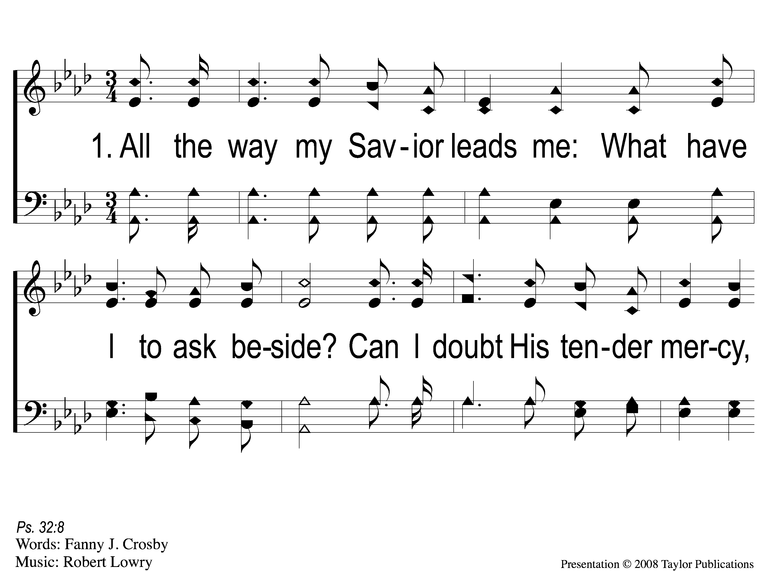
1-1 All the Way My Savior Leads Me
All the Way My Savior Leads Me
26

Slide 2
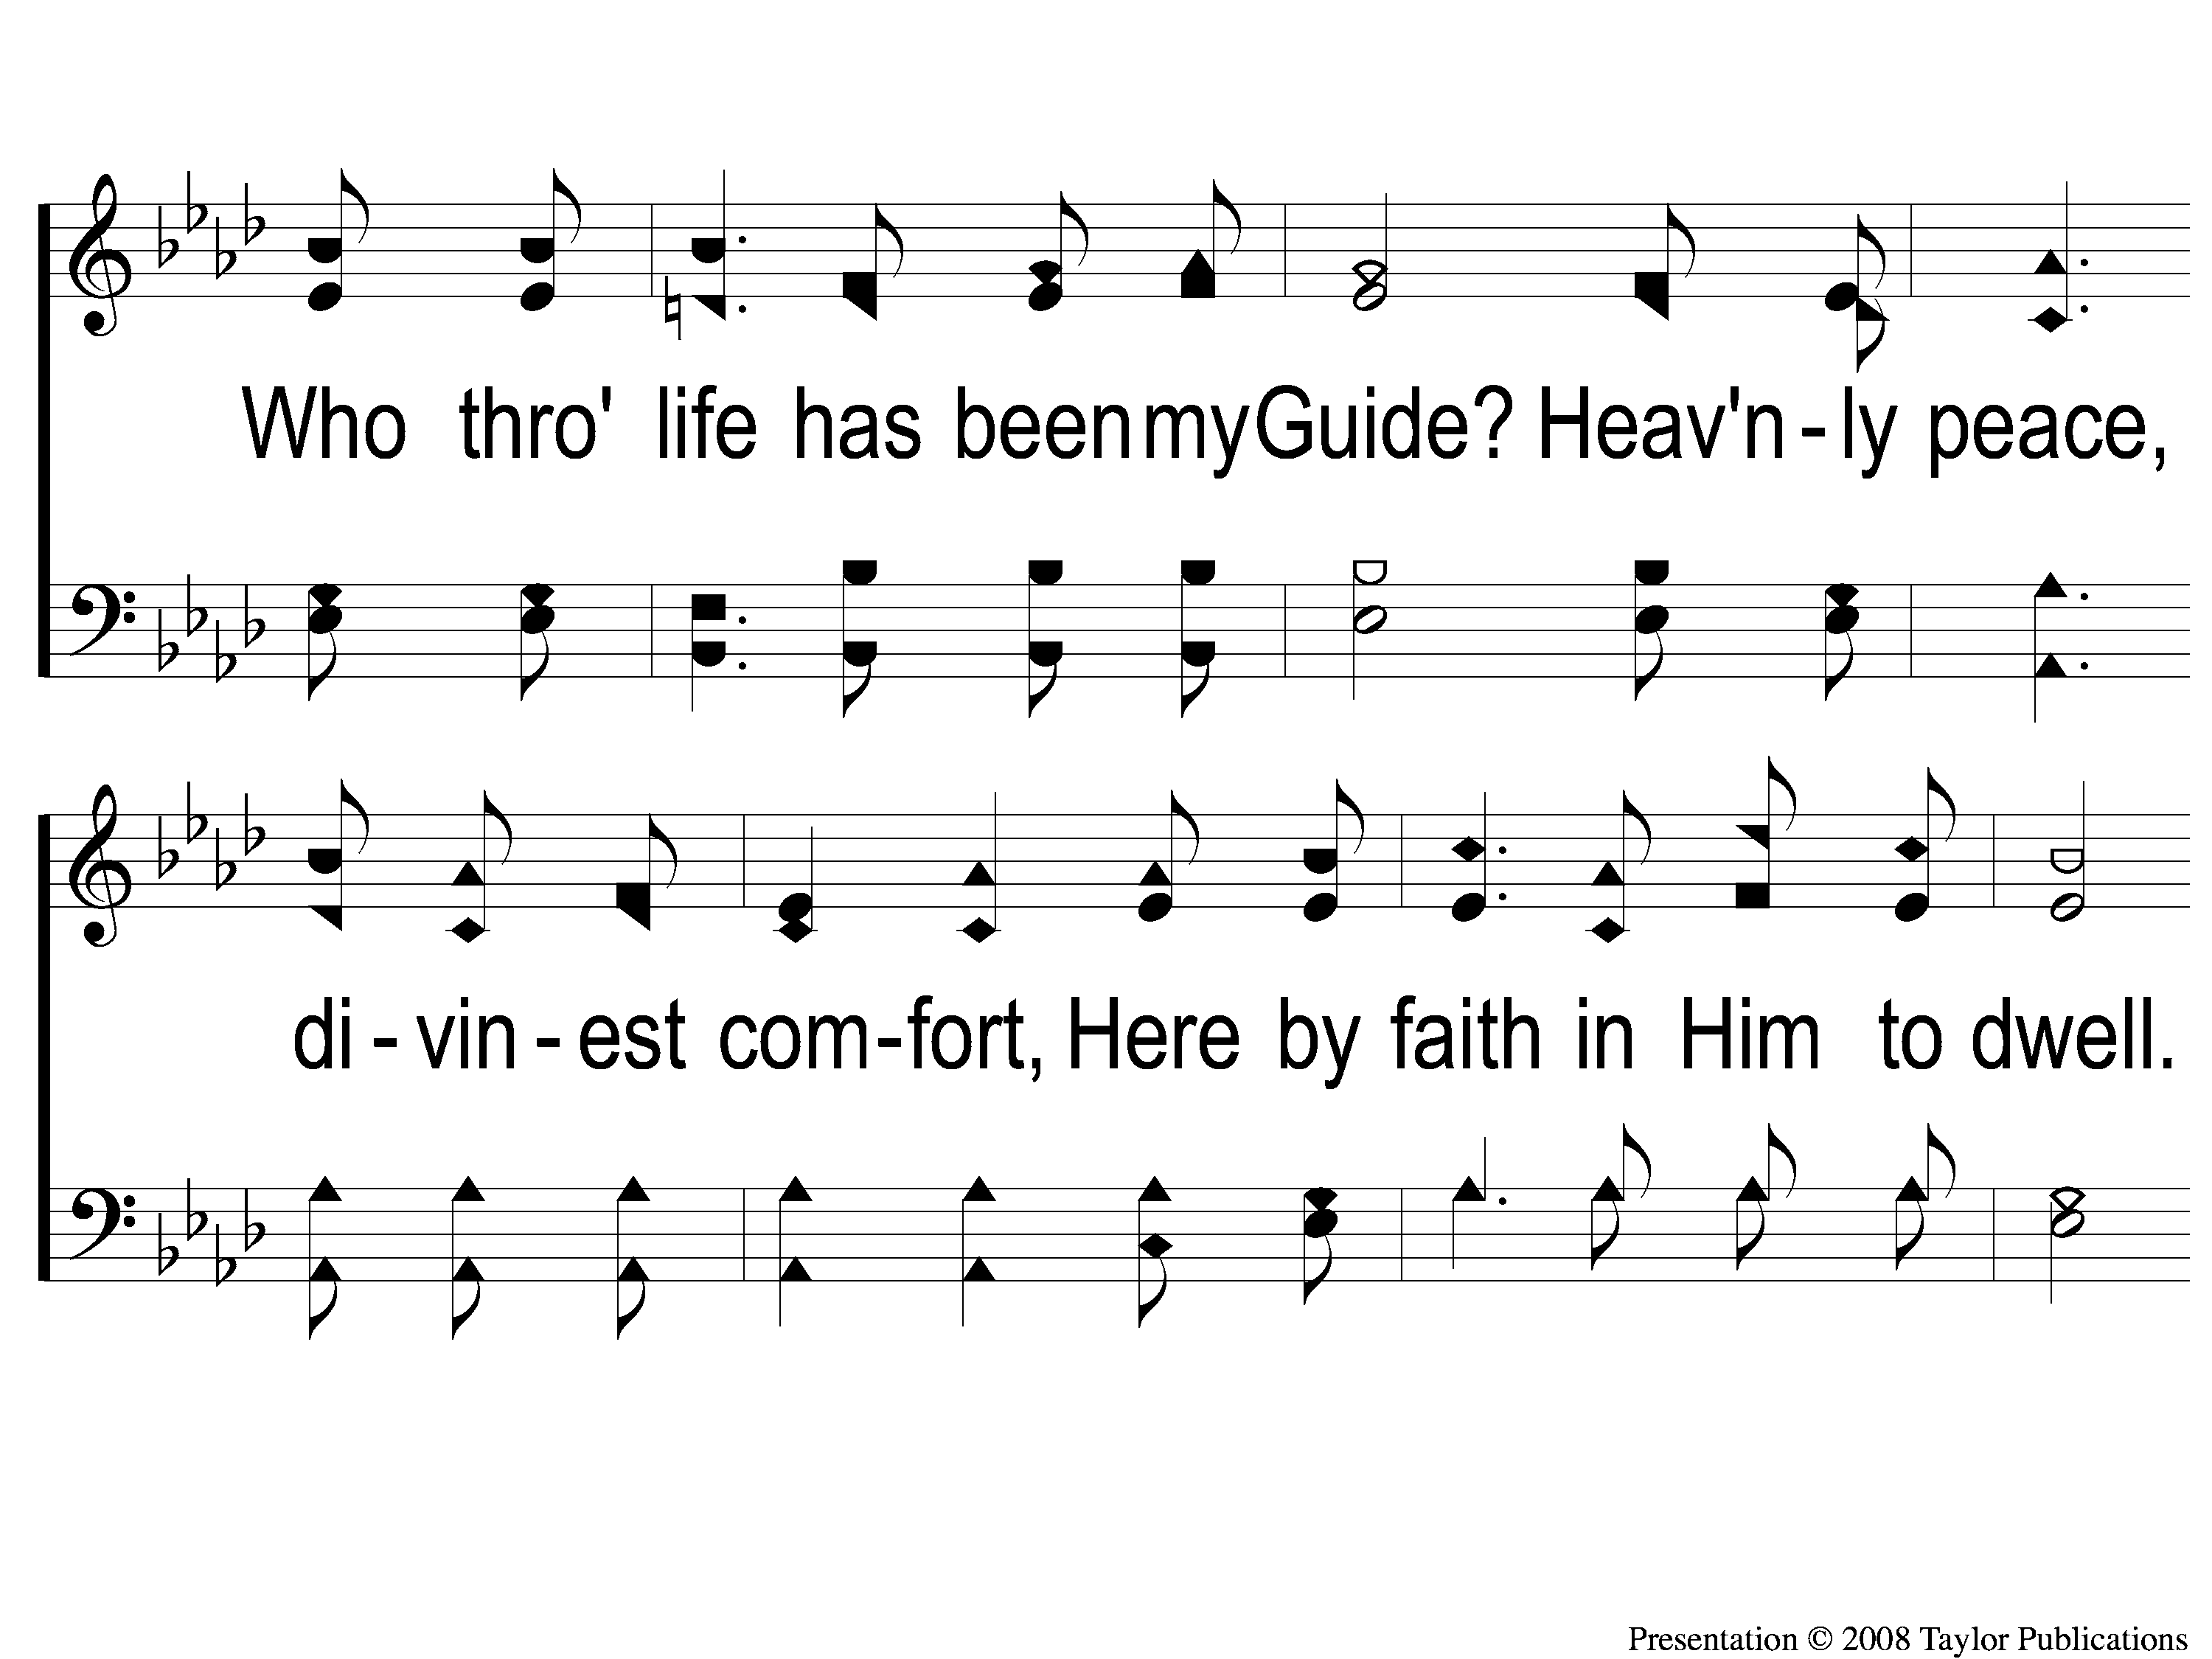
1-2 All the Way My Savior Leads Me
All the Way My Savior Leads Me
26

Slide 3
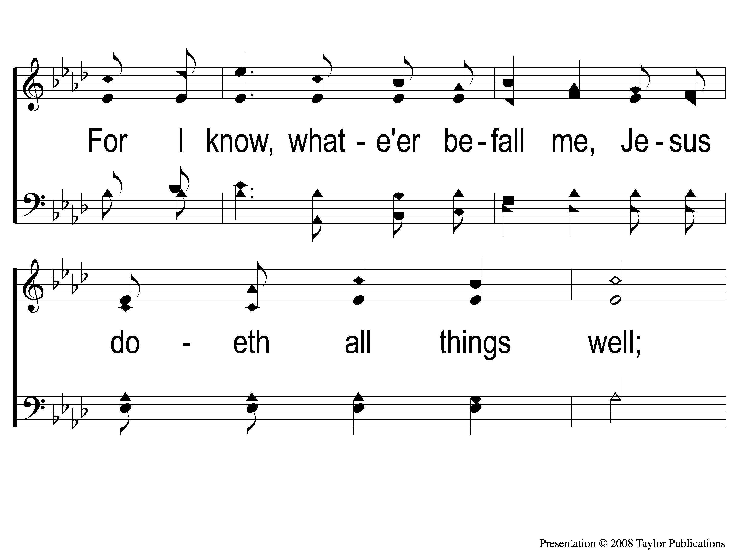
1-3 All the Way My Savior Leads Me
All the Way My Savior Leads Me
26

Slide 4
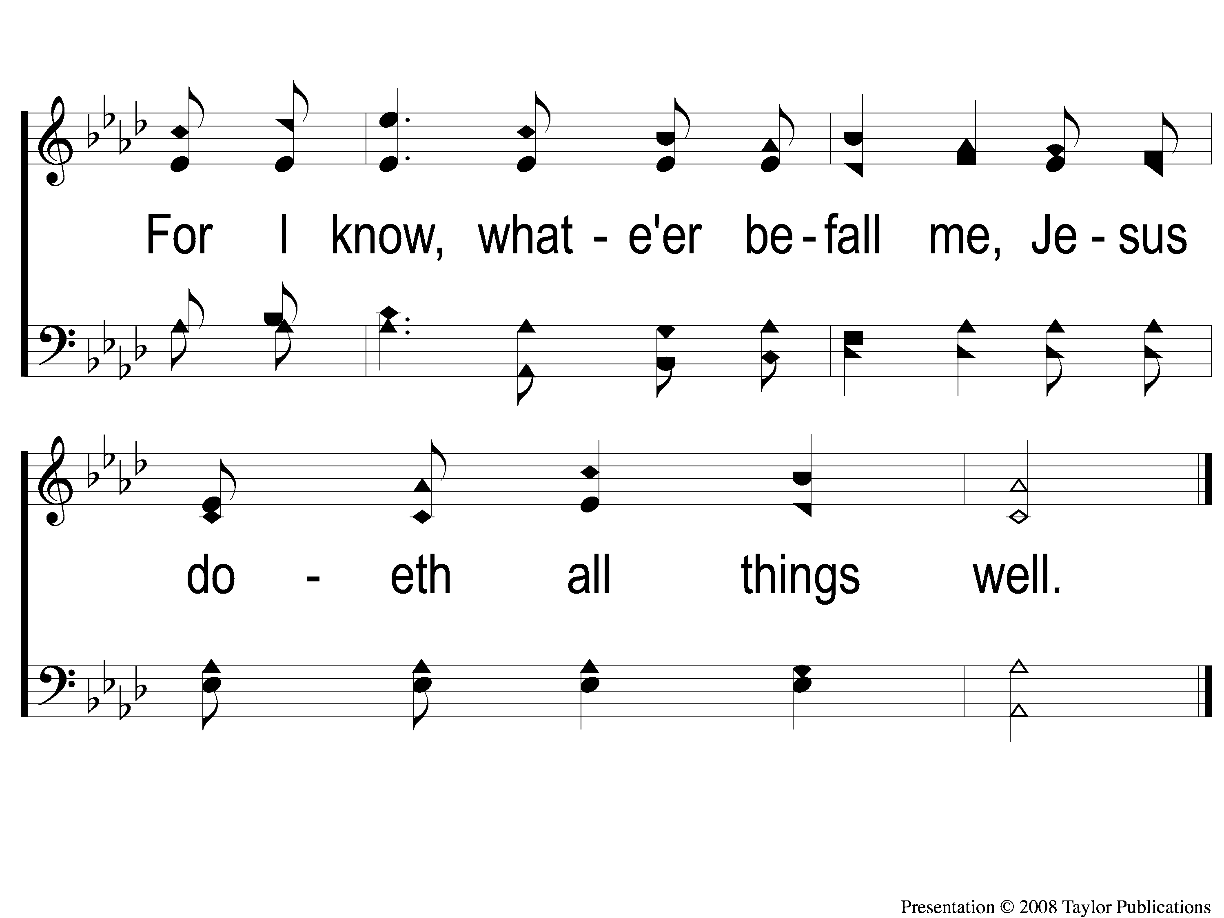
1-4 All the Way My Savior Leads Me
All the Way My Savior Leads Me
26

Slide 5
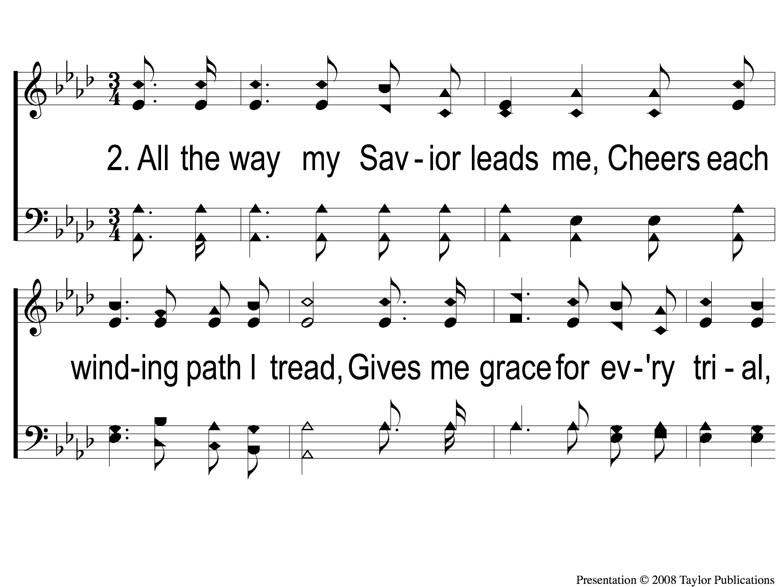
2-1 All the Way My Savior Leads Me
All the Way My Savior Leads Me
26

Slide 6
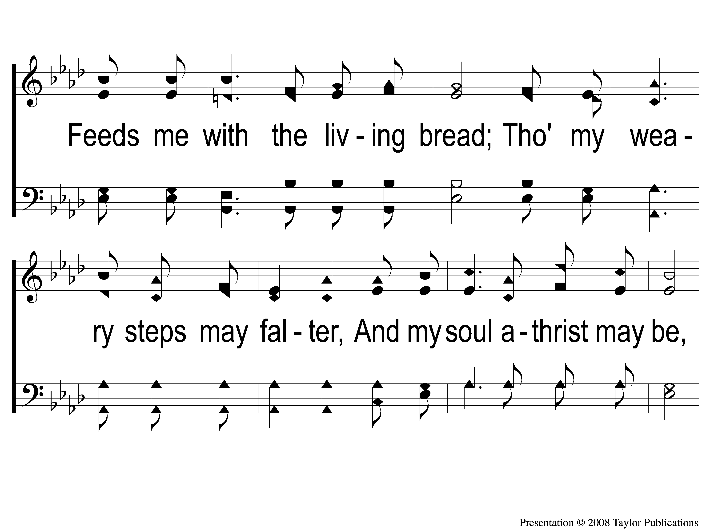
2-2 All the Way My Savior Leads Me
All the Way My Savior Leads Me
26

Slide 7
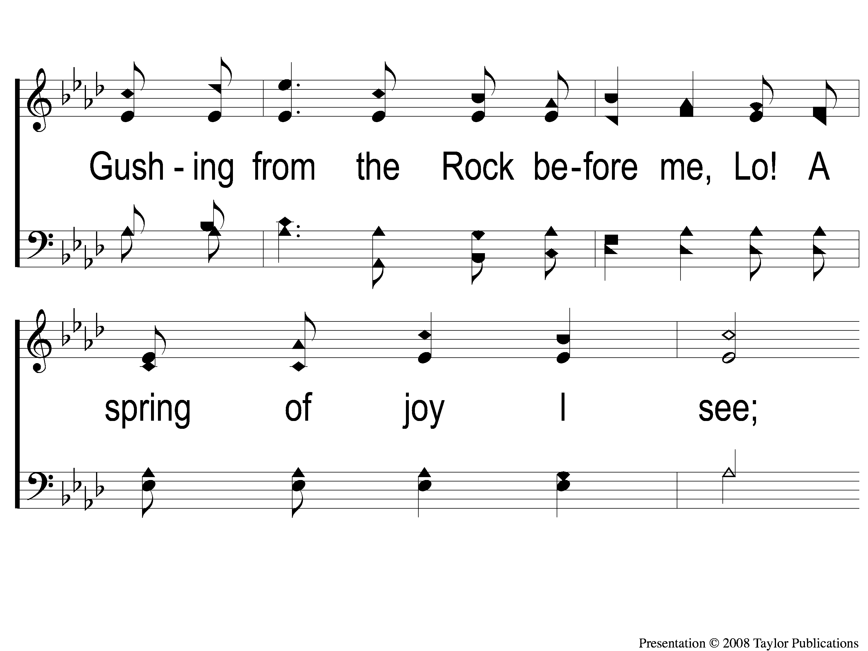
2-3 All the Way My Savior Leads Me
All the Way My Savior Leads Me
26

Slide 8
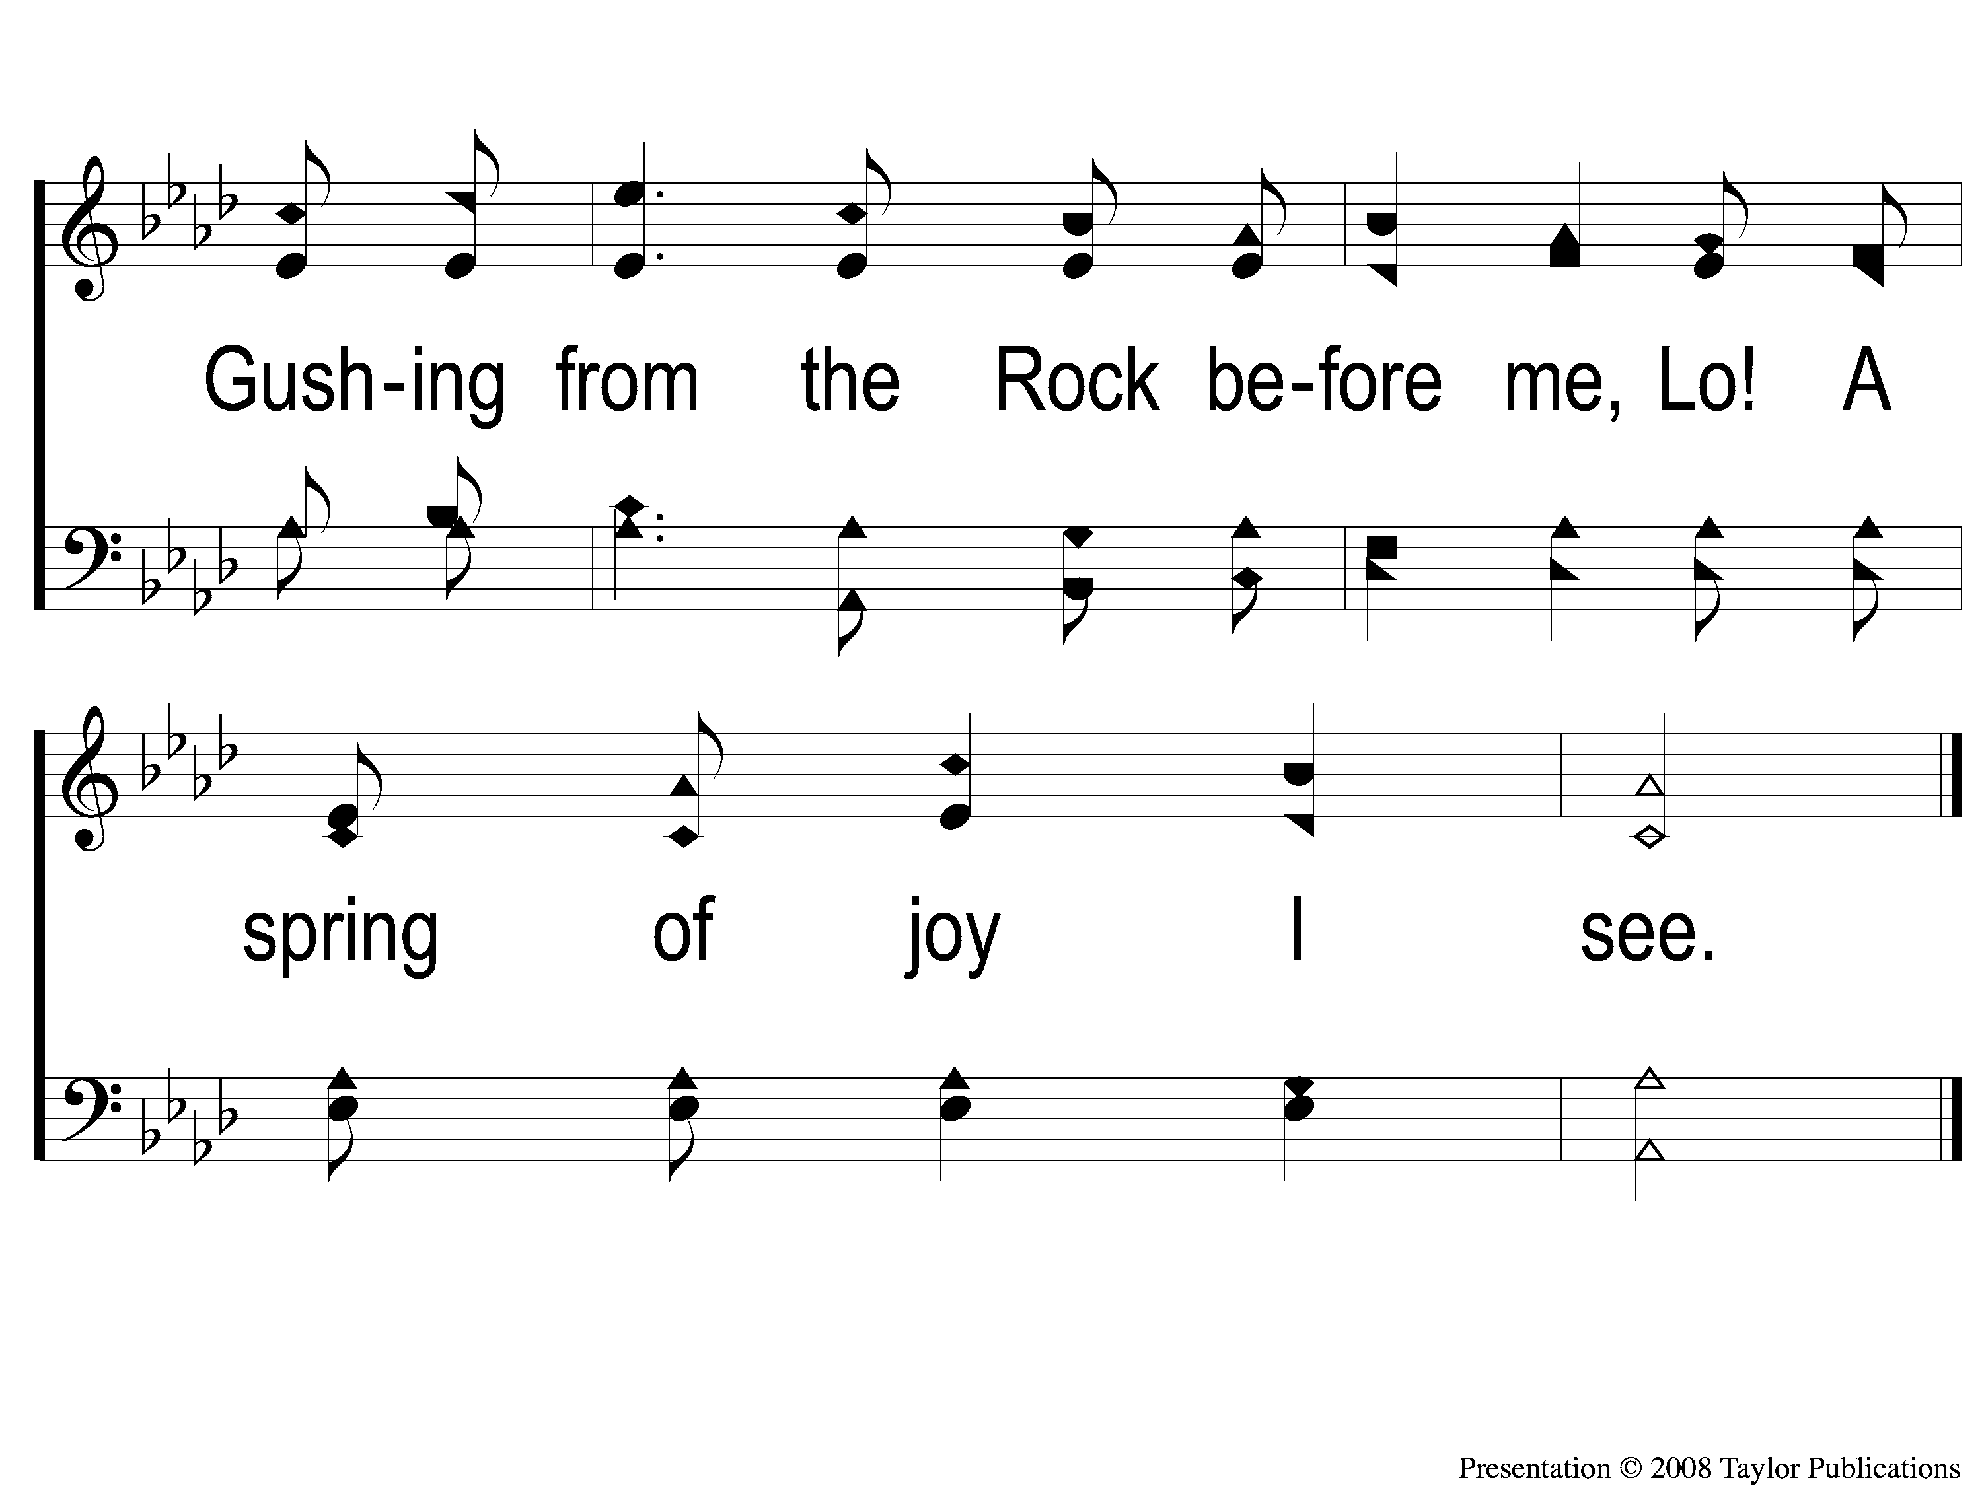
2-4 All the Way My Savior Leads Me
All the Way My Savior Leads Me
26

Slide 9
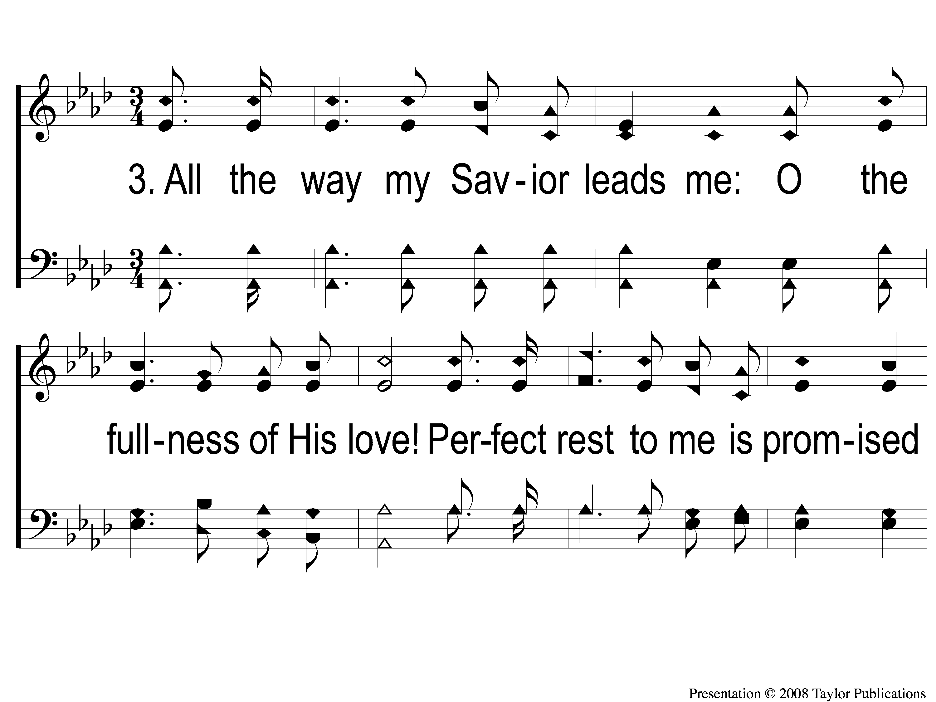
3-1 All the Way My Savior Leads Me
All the Way My Savior Leads Me
26

Slide 10
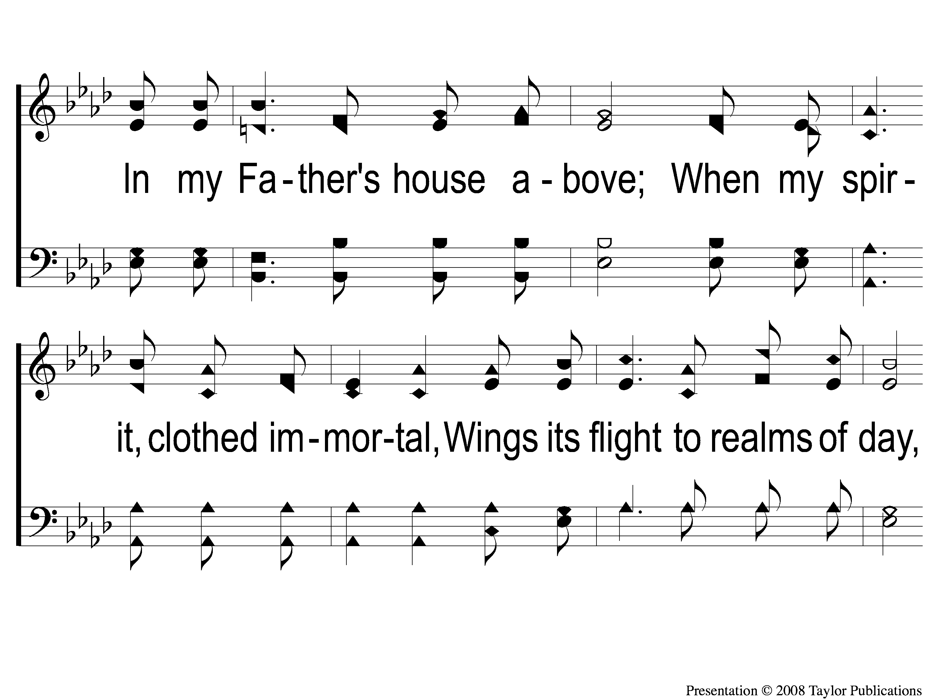
3-2 All the Way My Savior Leads Me
All the Way My Savior Leads Me
26

Slide 11
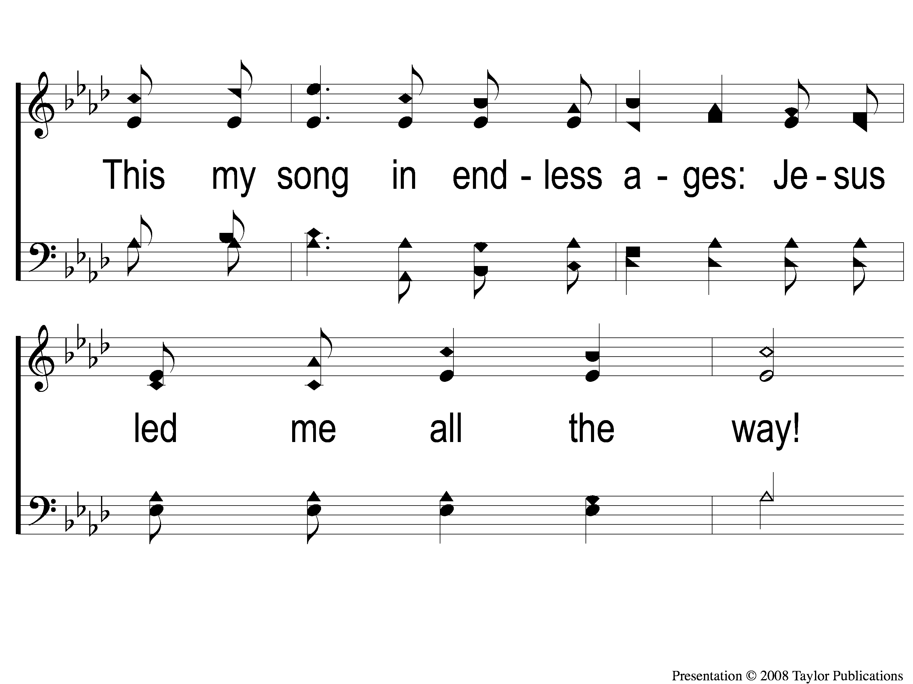
3-3 All the Way My Savior Leads Me
All the Way My Savior Leads Me
26

Slide 12
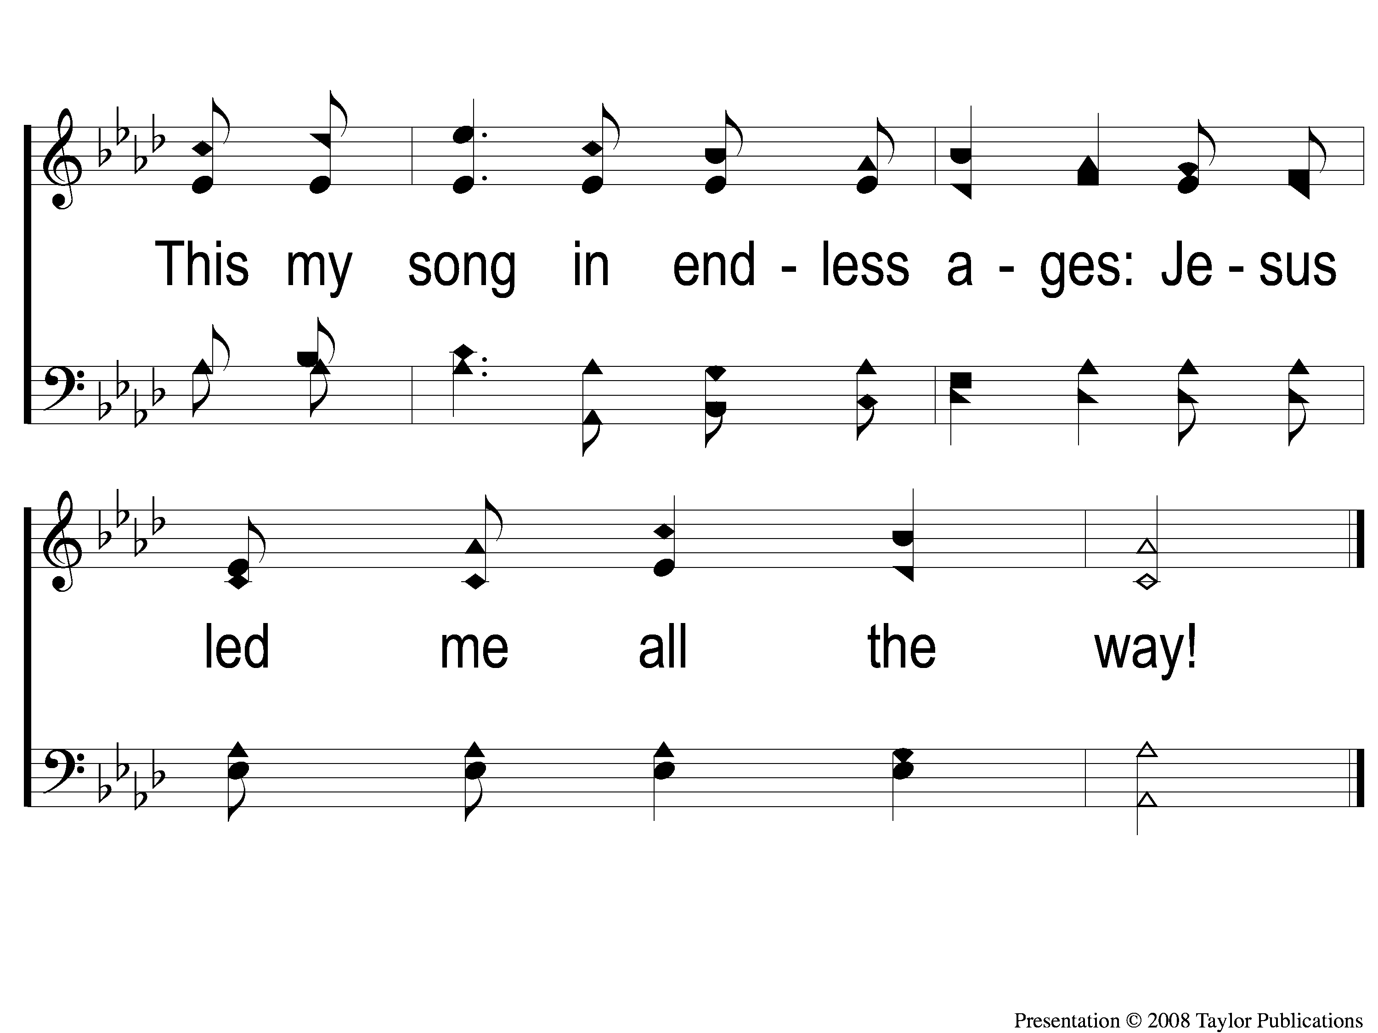
3-4 All the Way My Savior Leads Me
All the Way My Savior Leads Me
26

